Slide 1
Topics Covered in Todays Class
Unit 1: More Complex SQL queries
Nested Queries, Tuples and Set/Mutiset Comparison
CSE, KL luniversity

Slide 2
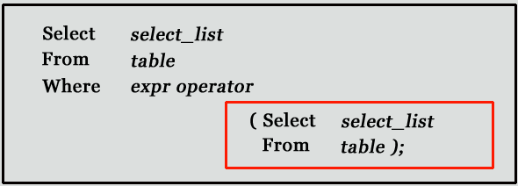
Subqueries or Nested Queries
A subquery is a SQL query nested inside a larger query.
SELECT colname1, colname2………. (SELECT ……….)
Note: Subqueries must be enclosed with in parenthesis
A subquery is usually added within the WHERE Clause of another SQL SELECT statement.
  We can use the comparison operators, such as >, <, or =. The comparison operator can also be a multiple-row operator, such as IN, ANY, SOME, or ALL.
A subquery can be treated as an inner query, which is a SQL query placed as a part of another query called as outer query.
The inner query executes first before its parent query so that the results of inner query can be passed to the outer query.
Outer Query
Inner Query
CSE, KL luniversity
Notes:
SELECT column-names
FROM table-name1
WHERE value IN (SELECT column-name
FROM table-name2
WHERE condition)

Slide 3
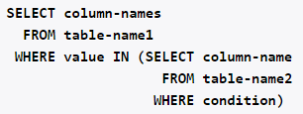
Subqueries or Nested Queries
A subquery is a SQL query nested inside a larger query.
SELECT colname1, colname2………. (SELECT ……….)
Note: Subqueries must be enclosed with in parenthesis
A subquery is usually added within the WHERE Clause of another SQL SELECT statement.
  We can use the comparison operators, such as >, <, or =. The comparison operator can also be a multiple-row operator, such as IN, ANY, SOME, or ALL.
A subquery can be treated as an inner query, which is a SQL query placed as a part of another query called as outer query.
The inner query executes first before its parent query so that the results of inner query can be passed to the outer query.
Outer Query
Inner Query
CSE, KL luniversity
Notes:
SELECT column-names
FROM table-name1
WHERE value IN (SELECT column-name
FROM table-name2
WHERE condition)

Slide 4
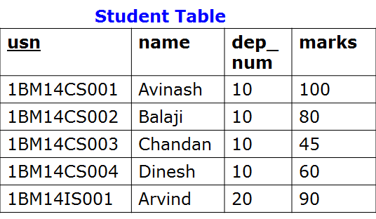
Subqueries
List names of the students whose marks score is greater than ‘Balaji’
CSE, KL luniversity

Slide 5
Subqueries
List names of the students whose marks score is greater than ‘Balaji’
Outer Query
Inner Query
CSE, KL luniversity

Slide 6
Subqueries
List names of the students whose marks score is greater than ‘Balaji’
Outer Query
80
Inner Query
CSE, KL luniversity

Slide 7

Subqueries
List names of the students whose marks score is greater than ‘Balaji’
CSE, KL luniversity

Slide 8
Subqueries
List name of the student whose marks score is second highest
CSE, KL luniversity

Slide 9

Subqueries
List name of the student whose marks score is second highest
CSE, KL luniversity

Slide 10
Subqueries : Using Comparisons
A subquery can be used before or after any of the comparison operators.
The subquery can return at most one value. The value can be the result of an arithmetic expression or a column function.
SQL then compares the value that results from the subquery with the value on the other side of the comparison operator. You can use the following comparison operators:
Operator | Description
= | Equal to
> | Greater than
>= | Greater than or equal to
< | Less than
<= | Less than or equal to
!= | Not equal to
CSE, KL luniversity

Slide 11
Activity To Do
movie_director(movie_title,pid) person(pid,name)
movie_title | pid
Guru | P1
Dasvathaaram | P2
Raavan | P1
pid | name
P1 | ManiRathnam
P2 | KamalHassan
Write Query to,
List down the movie titles directed by 'ManiRathnam'
CSE, KL luniversity
Notes:
movie(mid,title,year,rating,votes)

Slide 12

Activity To Do
movie_director(movie_title,pid) person(pid,name)
select movie_title
from movie_director
where pid=(select pid from person where name=‘ManiRatnam’);
movie_title | pid
Guru | P1
Dasvathaaram | P2
Raavan | P1
pid | name
P1 | ManiRathnam
P2 | KamalHassan
Write Query to,
List down the movie titles directed by 'ManiRathnam'
CSE, KL luniversity
Notes:
movie(mid,title,year,rating,votes)
http://www.w3resource.com/mysql/subqueries/index.php
Techtud correlated query
https://www.youtube.com/watch?v=gQCMp2K_yDI

Slide 13

Activity To Do
movie_director(movie_title,pid) person(pid,name)
movie_title | pid
Guru | P1
Dasvathaaram | P2
Raavan | P1
pid | name
P1 | ManiRathnam
P2 | KamalHassan
Write Query to,
List down the movie titles directed by 'ManiRathnam'
CSE, KL luniversity
Notes:
movie(mid,title,year,rating,votes)
http://www.w3resource.com/mysql/subqueries/index.php
Techtud correlated query
https://www.youtube.com/watch?v=gQCMp2K_yDI

Slide 14
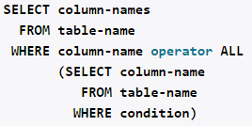
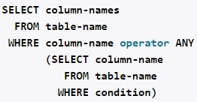
Subqueries with ALL, ANY, IN, or SOME
We can use a subquery after a comparison operator, followed by the keyword ALL, ANY, or SOME.
The ALL operator compares value to every value returned by the subquery. Therefore ALL operator (which must follow a comparison operator) returns TRUE if the comparison is TRUE for ALL of the values in the column that the subquery returns.
Syntax :
operand comparison_operator ALL (subquery)
CSE, KL luniversity

Slide 15
Subquery: ALL operator
> all means greater than every value, or greater than the maximum value.
For example, > all (1, 2, 3) means greater than 3.
CSE, KL luniversity
Notes:
https://oracle-base.com/articles/misc/all-any-some-comparison-conditions-in-sql
http://infocenter.sybase.com/help/index.jsp?topic=/com.sybase.infocenter.dc32300.1570/html/sqlug/sqlug191.htm

Slide 16
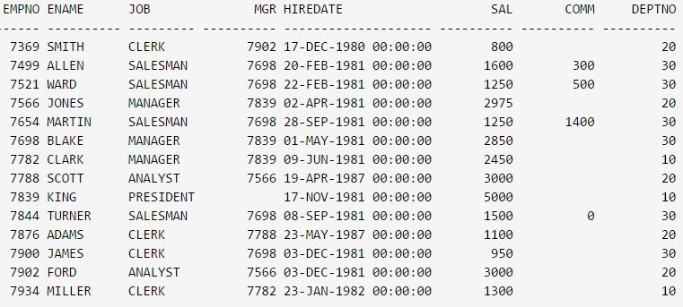
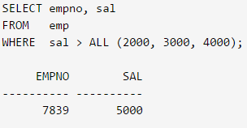
Subquery: ALL operator
> all means greater than every value, or greater than the maximum value.
CSE, KL luniversity
Notes:
https://oracle-base.com/articles/misc/all-any-some-comparison-conditions-in-sql
http://infocenter.sybase.com/help/index.jsp?topic=/com.sybase.infocenter.dc32300.1570/html/sqlug/sqlug191.htm

Slide 17
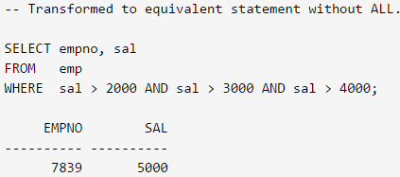
Subquery: ALL operator
> all means greater than every value, or greater than the maximum value.
CSE, KL luniversity
Notes:
https://oracle-base.com/articles/misc/all-any-some-comparison-conditions-in-sql
http://infocenter.sybase.com/help/index.jsp?topic=/com.sybase.infocenter.dc32300.1570/html/sqlug/sqlug191.htm

Slide 18
Activity To Do
List EMPNO and Salary of the employees whose salary is greater than the salary of all employees in the department 20
CSE, KL luniversity
Notes:
https://oracle-base.com/articles/misc/all-any-some-comparison-conditions-in-sql
http://infocenter.sybase.com/help/index.jsp?topic=/com.sybase.infocenter.dc32300.1570/html/sqlug/sqlug191.htm

Slide 19
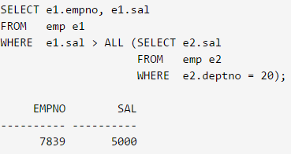
Activity To Do
List EMPNO and salary of the employees whose salary is greater than the salary of all employees in the department 20
CSE, KL luniversity
Notes:
https://oracle-base.com/articles/misc/all-any-some-comparison-conditions-in-sql
http://infocenter.sybase.com/help/index.jsp?topic=/com.sybase.infocenter.dc32300.1570/html/sqlug/sqlug191.htm

Slide 20
Subquery: ALL operator
> all means greater than all values
The > all operator means that, for a row to satisfy the condition in the outer query, the value in the column that introduces the subquery must be greater than each of the values returned by the subquery.
"x = ALL (...)": The value must match all the values in the list to evaluate to TRUE.
"x != ALL (...)": The value must not match any values in the list to evaluate to TRUE.
"x > ALL (...)": The value must be greater than the biggest value in the list to evaluate to TRUE.
"x < ALL (...)": The value must be smaller than the smallest value in the list to evaluate to TRUE.
"x >= ALL (...)": The value must be greater than or equal to the biggest value in the list to evaluate to TRUE.
"x <= ALL (...)": The value must be smaller than or equal to the smallest value in the list to evaluate to TRUE.
CSE, KL luniversity

Slide 21
Subquery: ANY operator
> any means greater than at least one value, or greater than the minimum value.
Therefore, > any (1, 2, 3) means greater than 1.
CSE, KL luniversity

Slide 22
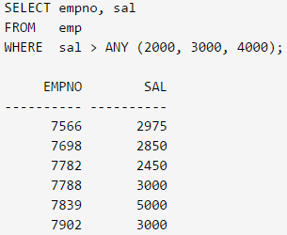
Subquery: ANY operator
> any means greater than at least one value, or greater than the minimum value.
CSE, KL luniversity

Slide 23
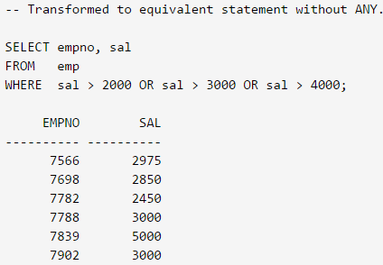
Subquery: ANY operator
> any means greater than at least one value, or greater than the minimum value.
CSE, KL luniversity

Slide 24
Activity To Do
List EMPNO and salary of the employees whose salary is greater than the salary of any employees in the department 10
CSE, KL luniversity
Notes:
https://oracle-base.com/articles/misc/all-any-some-comparison-conditions-in-sql
http://infocenter.sybase.com/help/index.jsp?topic=/com.sybase.infocenter.dc32300.1570/html/sqlug/sqlug191.htm

Slide 25
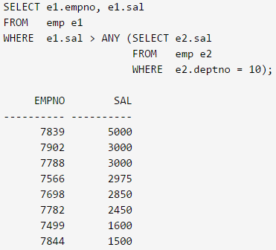
Activity To Do
List EMPNO and salary of the employees whose salary is greater than the salary of any employees in the department 10
CSE, KL luniversity
Notes:
https://oracle-base.com/articles/misc/all-any-some-comparison-conditions-in-sql
http://infocenter.sybase.com/help/index.jsp?topic=/com.sybase.infocenter.dc32300.1570/html/sqlug/sqlug191.htm

Slide 26
Subquery: ANY operator
> any means greater than at least one value
> any means that, for a row to satisfy the outer query, the value in the column that introduces the subquery must be greater than at least one of the values in the list returned by the subquery.
"x = ANY (...)": The value must match one or more values in the list to evaluate to TRUE.
"x != ANY (...)": The value must not match one or more values in the list to evaluate to TRUE.
"x > ANY (...)": The value must be greater than the smallest value in the list to evaluate to TRUE.
"x < ANY (...)": The value must be smaller than the biggest value in the list to evaluate to TRUE.
"x >= ANY (...)": The value must be greater than or equal to the smallest value in the list to evaluate to TRUE.
"x <= ANY (...)": The value must be smaller than or equal to the biggest value in the list to evaluate to TRUE.
CSE, KL luniversity

Slide 27
Subquery: SOME operator
The SOME and ANY comparison conditions do exactly the same thing and are completely interchangeable.
CSE, KL luniversity

Slide 28

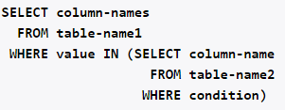
Subquery: IN Operator
Syntax
The number of values in the parenthesis can be
one or more, with each values separated by comma.
Values can be numerical or characters. If there is
only one value inside the parenthesis, this
command is equivalent to,
CSE, KL luniversity

Slide 29
Subquery: IN Operator
Syntax
The number of values in the parenthesis can be
one or more, with each values separated by comma.
Values can be numerical or characters. If there is
only one value inside the parenthesis, this
command is equivalent to,
CSE, KL luniversity

Slide 30
Subquery: IN Operator
Find the names of the publishers who have published CSE books:
publisher
titles
pid | pub_name
1 | Pearson
2 | Tata
3 | ABP
4 | GitaPress
pid | type
1 | CSE
2 | ISE
3 | CSE
4 | EC
CSE, KL luniversity

Slide 31
Subquery: IN Operator
Find the names of the publishers who have published CSE books:
publisher
titles
pid | pub_name
1 | Pearson
2 | Tata
3 | ABP
4 | GitaPress
pid | type
1 | CSE
2 | ISE
3 | CSE
4 | EC
select pub_name
from publisher
where pid in (select pid
from titles
where type = ‘CSE’)
pub_name
------------
Pearson
ABP
CSE, KL luniversity

Slide 32
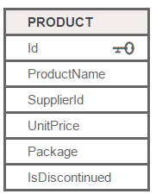
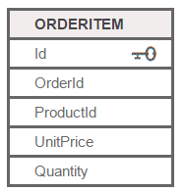
Activity To Do
List products with order quantities greater than 100.
CSE, KL luniversity
Notes:
https://oracle-base.com/articles/misc/all-any-some-comparison-conditions-in-sql
http://infocenter.sybase.com/help/index.jsp?topic=/com.sybase.infocenter.dc32300.1570/html/sqlug/sqlug191.htm

Slide 33
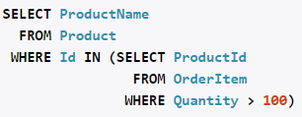
Activity To Do
List products with order quantities greater than 100.
CSE, KL luniversity
Notes:
https://oracle-base.com/articles/misc/all-any-some-comparison-conditions-in-sql
http://infocenter.sybase.com/help/index.jsp?topic=/com.sybase.infocenter.dc32300.1570/html/sqlug/sqlug191.htm
http://www.1keydata.com/sql/sql-select-unique.html

Slide 34
Topics Covered in Todays Class
Unit 1: More Complex SQL queries
Correlated SubQueries
EXISTS operator
CSE, KL luniversity

Slide 35
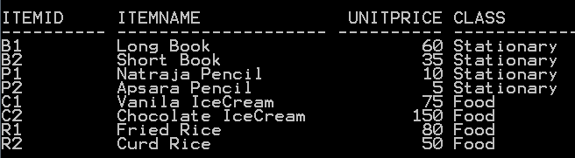
Illustration why we need to construct Correlated Sub Queries
List the details of the item which is having maximum unitprice in each class
CSE, KL luniversity

Slide 36

Illustration why we need to construct Correlated Sub Queries
List the details of the item which is having maximum unitprice in each class
Item
Class
Group 1
Class
Group 2
Output
CSE, KL luniversity

Slide 37
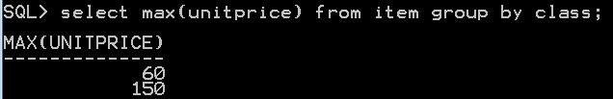
Illustration: Why we need Correlated Sub Queries
List the maximum unitprice in each class
Item
Class
Group 1
Class
Group 2
CSE, KL luniversity

Slide 38
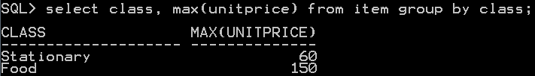
Illustration: Why we need Correlated Sub Queries
List the class name and maximum unitprice in each class
Item
Class
Group 1
Class
Group 2
CSE, KL luniversity

Slide 39
Illustration: Why we need Correlated Sub Queries
List the class name and maximum unitprice in each class
Item
Class
Group 1
Class
Group 2
CSE, KL luniversity

Slide 40
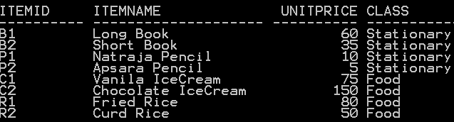
Illustration: Why we need Correlated Sub Queries
List the Item name, maximum unitprice and class name in each class
Item table
Class
Group 1
Class
Group 2
Output should be
ItemName max(unitPrice) Class
-------------------------------------------------
Long Book 60 Stationary
Chocolate IceCream 150 Food
CSE, KL luniversity

Slide 41
Illustration: Why we need Correlated Sub Queries
List the Item name, maximum unitprice and class name in each class
Item table
Class
Group 1
Class
Group 2
CSE, KL luniversity

Slide 42
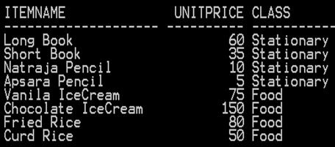
Illustration: Why we need Correlated Sub Queries
List the Item name, maximum unitprice and class name of the item which is having maximum unitprice in each class
Item
select itemname,
max(unitprice) unitprice,class
from item
group by class,itemname;
CSE, KL luniversity

Slide 43
SQL GROUP BY Statement
The GROUP BY statement is used in conjunction with the aggregate functions to group the result-set by one or more columns.
SQL GROUP BY Syntax
SELECT column_name, aggregate_function(column_name)
FROM table_name
[Where .............]
GROUP BY column_name
One purpose of grouping is to display count, averages, sum, minimum, maximum values for each group. Note that in the result of such a query, we see only one line per group.
CSE, KL luniversity

Slide 44
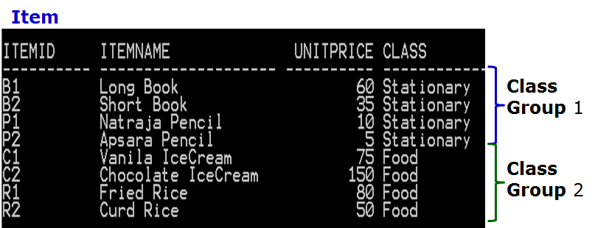

Illustration: Why we need Correlated Queries
List the class name and max,min,sum, average Unitprice and number of items in each class
Class max(unitprice) min(unitprice) sum(unitprice) avg(unitprice) count(*)
----------------------------------------------------------------------------------------------
Stationary 60 5 110 27.5 4
Food 150 50 355 88.75 4
CSE, KL luniversity

Slide 45
Say, we want to
List the details of the item which is having maximum unitprice in each class
Item
Class
Group 1
Class
Group 2
Output
CSE, KL luniversity

Slide 46
What is Independent Sub Query or Non Correlated Sub Query ?
A subquery is a SELECT statement within another statement.
Outer Query
SELECT t1.column1
FROM table t1 WHERE t1.column1 IN (SELECT t2.column1
FROM table t2
where t2.column2 >10 );
CSE, KL luniversity

Slide 47
What is Independent Sub Query or Non Correlated Sub Query ?
A subquery is a SELECT statement within another statement.
Outer Query
SELECT t1.column1
FROM table t1 WHERE t1.column1 IN (SELECT t2.column1
FROM table t2
where t2.column2 >10 );
Inner Query
Not dependent on columns of
Outer Query
CSE, KL luniversity

Slide 48
What is Correleated Sub Query ?
A correlated subquery is a subquery that contains a reference to a table that also appears in the outer query.
Outer Query
SELECT t1.column1
FROM table t1 WHERE t1.column1 IN (SELECT t2.column1
FROM table t2
where t2.column2 >t1.column2);
CSE, KL luniversity
Notes:
SELECT * FROM t1 WHERE column1 = ANY (SELECT column1 FROM t2 WHERE t2.column2 = t1.column2);

Slide 49
What is Correleated Sub Query ?
A correlated subquery is a subquery that contains a reference to a table that also appears in the outer query.
Outer Query
SELECT t1.column1
FROM table t1 WHERE t1.column1 IN (SELECT t2.column1
FROM table t2
where t2.column2 >t1.column2);
Inner Query
is dependent on columns of
Outer Query
i.e., t2.colum2=t1.column2
CSE, KL luniversity
Notes:
SELECT * FROM t1 WHERE column1 = ANY (SELECT column1 FROM t2 WHERE t2.column2 = t1.column2);

Slide 50
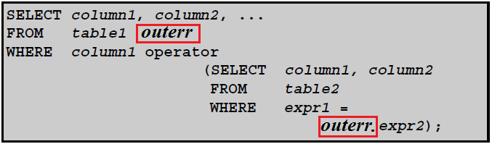
What is Correlated Sub Query
A correlated subquery is a subquery that contains a reference to a table (in the parent query) that also appears in the outer query. SQL evaluates from inside to outside.
Correlated subquery syntax :
The inner Query is executed separately for each row of the outer query.SQL performs a subquery over and over again – once for each row of the main query.
CSE, KL luniversity
Notes:
http://infocenter.sybase.com/help/index.jsp?topic=/com.sybase.infocenter.dc32300.1570/html/sqlug/sqlug191.htm
http://www.w3resource.com/mysql/subqueries/index.php
Main difference between Correlated and Noncorrelated subquery is that, Correlated subquery depends upon Outer query and can not execute by its own while in Noncorrelated subquery both outer query and inner query are independent to each other.

Slide 51
Correlated Queries
List the details of the item which is having maximum unitprice in each class
Item
CSE, KL luniversity

Slide 52
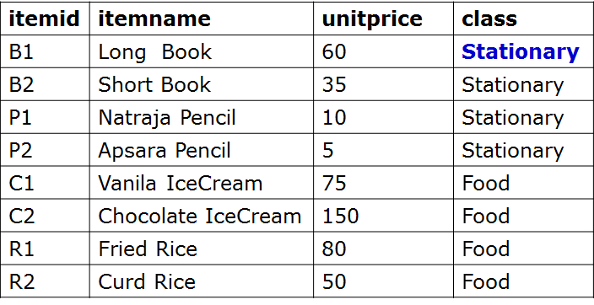
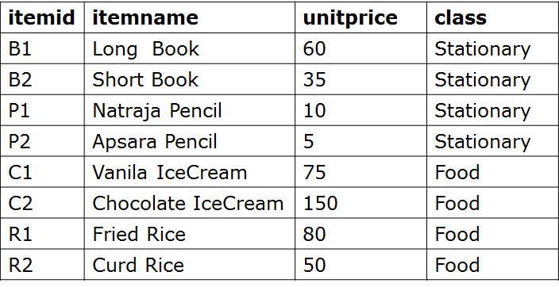
Logic of correlated sub queries
Outer item table
Inner item table
CSE, KL luniversity

Slide 53
Logic of correlated sub queries
Outer item table
Step 1
For every record of outer query
Pick the class name
Stationary
Inner item table
CSE, KL luniversity

Slide 54
Logic of correlated sub queries
Outer item table
Step 1
For every record of outer query
Pick the class name
Stationary
Step 2
In the inner query
Find maximum unitprice of class name picked
from outer query
i.e compare class name of outer with inner
Inner item table
Max 60
CSE, KL luniversity

Slide 55
Logic of correlated sub queries
Outer item table
Step 1
For every record of outer query
Pick the class name
Stationary
Step 2
In the inner query
Find maximum unitprice of class name picked
from outer query
i.e compare class name of outer with inner
Step 3
Check if equal, unit price
of outer query
with maximum
unit price of inner query
Inner item table
Max 60
CSE, KL luniversity

Slide 56
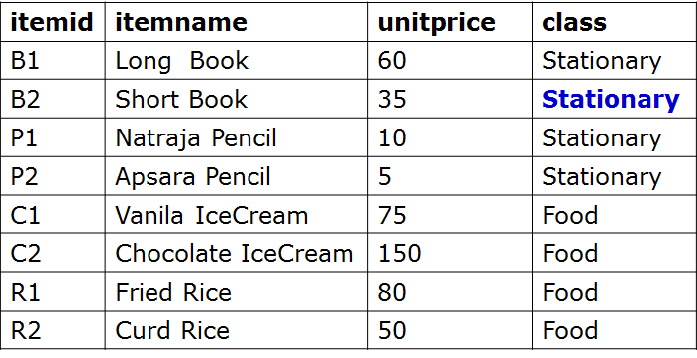
Logic of correlated sub queries
Outer item table
Step 1
For every record of outer query
Pick the class name
Stationary
Step 2
In the inner query
Find maximum unitprice of class name picked
from outer query
i.e compare class name of outer with inner
Step 3
Check if equal, unit price
of outer query
with maximum
unit price of inner query
Inner item table
Max 60
CSE, KL luniversity

Slide 57
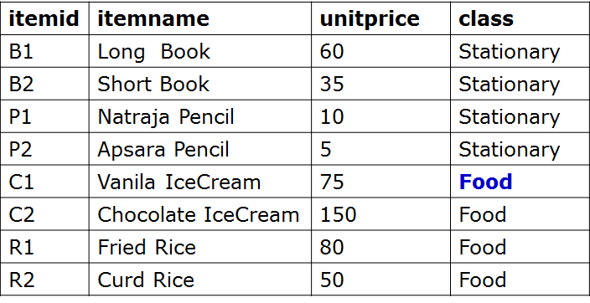
Logic of correlated sub queries
Outer item table
Step 1
For every record of outer query
Pick the class name
Food
Step 2
In the inner query
Find maximum unitprice of class name picked
from outer query
i.e compare class name of outer with inner
Step 3
Check if equal, unit price
of outer query
with maximum
unit price of inner query
Inner item table
Max 150
CSE, KL luniversity

Slide 58

Non Correlated Sub Query
Using IN Operator
Item
CSE, KL luniversity

Slide 59
Observation
Question : Why the Error is getting generated when we run the following Query ?
Item
CSE, KL luniversity

Slide 60
Observation
Question: Justify why we are getting the following output when we run the query as shown below
Item
Output
CSE, KL luniversity

Slide 61
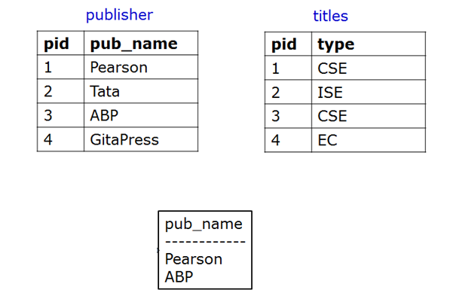
Illustration of Subquery EXISTS Operator
Find the names of the publishers who have published CSE books:
OUTPUT should be
CSE, KL luniversity

Slide 62
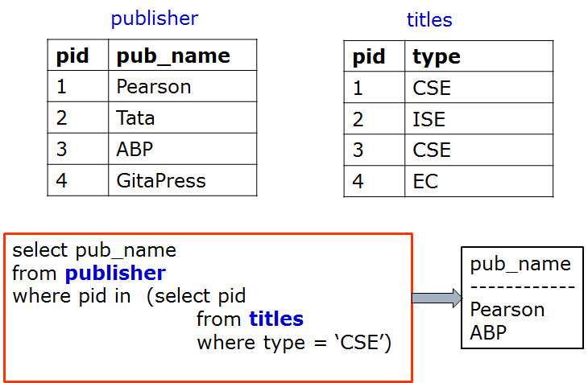
Without using Subquery EXISTS Operator
Find the names of the publishers who have published CSE books:
Non Correlated Sub Query: Using IN operator
CSE, KL luniversity

Slide 63
Without using Subquery EXISTS Operator
Find the names of the publishers who have published CSE books:
Using Cartesian product or Cross Join
publisher
titles
pid | pub_name
1 | Pearson
2 | Tata
3 | ABP
4 | GitaPress
pid | type
1 | CSE
2 | ISE
3 | CSE
4 | EC
pub_name
------------
Pearson
ABP
select pub_name
from publisher p, titles t
where p.pid = t.pid and t.type=‘CSE’;
CSE, KL luniversity

Slide 64
Without using Subquery EXISTS Operator
Find the names of the publishers who have published CSE books:
Using Correlated sub query
publisher
titles
pid | pub_name
1 | Pearson
2 | Tata
3 | ABP
4 | GitaPress
pid | type
1 | CSE
2 | ISE
3 | CSE
4 | EC
pub_name
------------
Pearson
ABP
select pub_name
from publisher p
where p.pid = (select t.pid from titles t
where t.pid = p.pid and t.type=‘CSE’;
CSE, KL luniversity

Slide 65
Subquery: EXISTS Operator
The EXISTS keyword is used to check whether a sub query produces any row(s) of result.
If the query following the EXISTS return at least one row, then EXISTS returns TRUE
If the query following the EXISTS returns no rows, then EXISTS returns FALSE
CSE, KL luniversity

Slide 66
Subquery: EXISTS Operator
Find the names of the publishers who have published CSE books:
Using Exists Operator
publisher
titles
pid | pub_name
1 | Pearson
2 | Tata
3 | ABP
4 | GitaPress
pid | type
1 | CSE
2 | ISE
3 | CSE
4 | EC
select pub_name
from publisher p
where exists (select * from titles t
where t.pid = p.pid
and type = ‘CSE’)
pub_name
------------
Pearson
ABP
CSE, KL luniversity

Slide 67
Subquery: EXISTS Operator
Why we will get the following output when we run the query as shown below ?
publisher
titles
pid | pub_name
1 | Pearson
2 | Tata
3 | ABP
4 | GitaPress
pid | type
1 | CSE
2 | ISE
3 | CSE
4 | EC
OUTPUT
pub_name
------------
Pearson
Tata
ABP
GitaPress
select pub_name
from publisher p
where exists (select * from titles t
where type = ‘CSE’)
CSE, KL luniversity

Slide 68
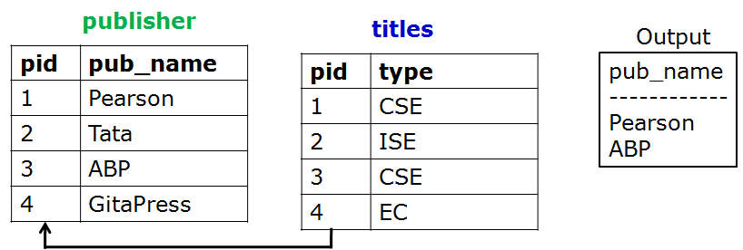
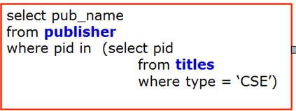
Different ways of framing query for same output
S4
S1
select pub_name
from publisher p
where exists (select * from titles t
where t.pid = p.pid
and type = ‘CSE’)
select pub_name
from publisher p, titles t
where p.pid = t.pid and t.type=‘CSE’;
S2
select pub_name
from publisher p
where p.pid = (select t.pid from titles t
where t.pid = p.pid and t.type=‘CSE’;
S3
CSE, KL luniversity

Slide 69
Subquery: NOT EXISTS Operator
The NOT EXISTS keyword is used to check whether a sub query produces any row(s) of result.
If the query following the NOT EXISTS returns no row, then NOT EXISTS returns TRUE
If the query following the NOT EXISTS returns any row(s), then NOT EXISTS returns FALSE
CSE, KL luniversity

Slide 70
Subquery: NOT EXISTS Operator
not exists is just like exists except that the where clause in which it is used is satisfied when no rows are returned by the subquery.
Find the names of publishers who do not publish CSE books
publisher
titles
pid | pub_name
1 | Pearson
2 | Tata
3 | ABP
4 | GitaPress
pid | type
1 | CSE
2 | ISE
3 | CSE
4 | EC
OUTPUT should be
pub_name
------------
Tata
GitaPress
CSE, KL luniversity
Notes:
select pub_name from publishers where not exists (select * from titles where pub_id = publishers.pub_id and type = "business")

Slide 71
Subquery: NOT EXISTS Operator
not exists is just like exists except that the where clause in which it is used is satisfied when no rows are returned by the subquery.
Find the names of publishers who do not publish CSE books:
publisher
titles
pid | pub_name
1 | Pearson
2 | Tata
3 | ABP
4 | GitaPress
pid | type
1 | CSE
2 | ISE
3 | CSE
4 | EC
select pub_name
from publisher
where not exists (select * from titles
where pid = publisher.pid
and type = ‘CSE’)
pub_name
------------
Tata
GitaPress
CSE, KL luniversity
Notes:
select pub_name from publishers where not exists (select * from titles where pub_id = publishers.pub_id and type = "business")

Slide 72
Subqueries with EXISTS or NOT EXISTS
The EXISTS operator tests for existence of rows in the results set of the subquery. If a subquery row value is found, EXISTS subquery is TRUE and in this case NOT EXISTS subquery is FALSE.
Syntax :
SELECT column1 FROM table1 WHERE EXISTS (SELECT * FROM table2);
Use the exists keyword with a subquery to test for the existence of some result from the subquery:
{where | having} [not] exists (subquery)
That is, the where clause of the outer query tests for the existence of the rows returned by the subquery. The subquery does not actually produce any data, but returns a value of TRUE or FALSE.
CSE, KL luniversity

Slide 73
Subquery: UNIQUE Operator
The UNIQUE keyword is used to check whether a sub query produces any row(s) of result.
If the subquery following the UNIQUE returns no two rows identical then UNIQUE returns TRUE
If the subquery following the UNIQUE returns atleast any two rows identical, then UNIQUE returns FALSE
CSE, KL luniversity
Notes:
the UNIQUE predicate evaluates to True only if no two rows returned by the subquery are identical. In other words, the UNIQUE predicate evaluates to True only if all the rows that its subquery returns are unique.

Slide 74
Summary
In independent sub query the inner query executes first and then the outer query executes utilizing the result obtained by inner query.
In correlated sub query the inner query executed once for every row of the outer query.
EXISTS returns TRUE if the inner query used returns any one record.
NOT EXISTS returns TRUE if the inner query does not return anything.
CSE, KL luniversity

